Slide 1
You will see each face for 5 seconds. You will then have 10 seconds to write down the emotion expressed.

Slide 2
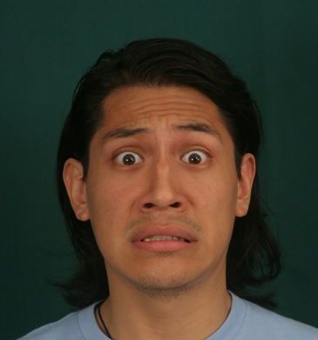

Slide 3
You have 10 seconds to write.

Slide 4
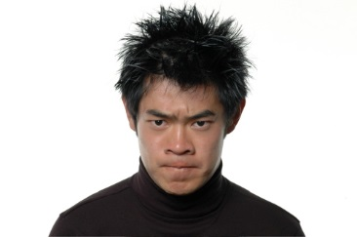

Slide 5
You have 10 seconds to write.

Slide 6
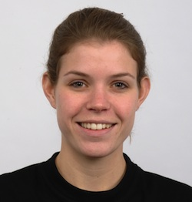

Slide 7
You have 10 seconds to write.

Slide 8
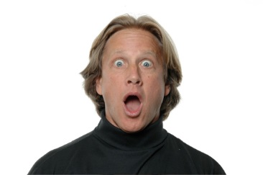

Slide 9
You have 10 seconds to write.

Slide 10
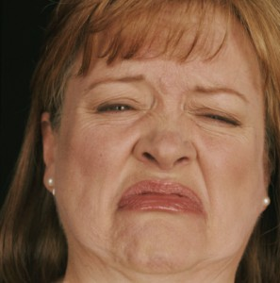

Slide 11
You have 10 seconds to write.

Slide 12
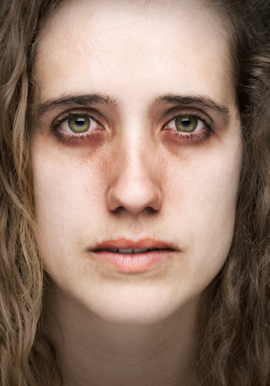

Slide 13
You have 10 seconds to write.

Slide 14


Slide 15
You have 10 seconds to write.

Slide 16
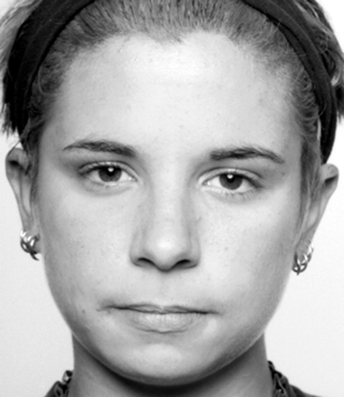

Slide 17
You have 10 seconds to write.

Slide 18
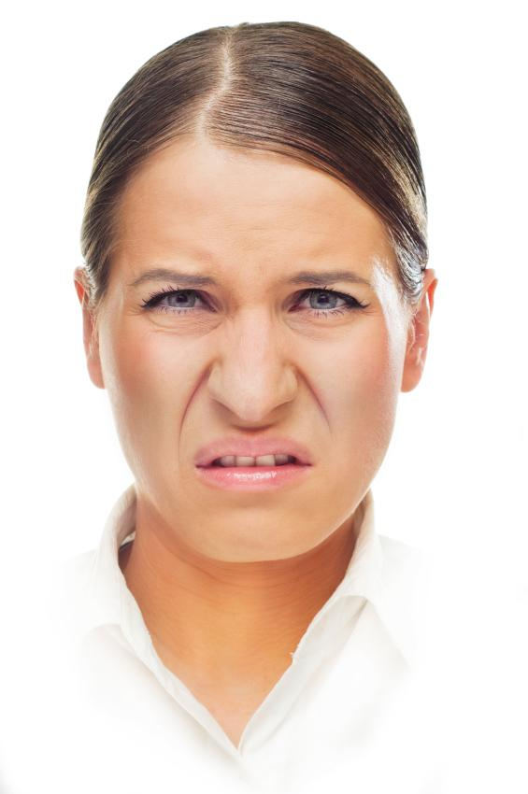

Slide 19
You have 10 seconds to write.

Slide 20
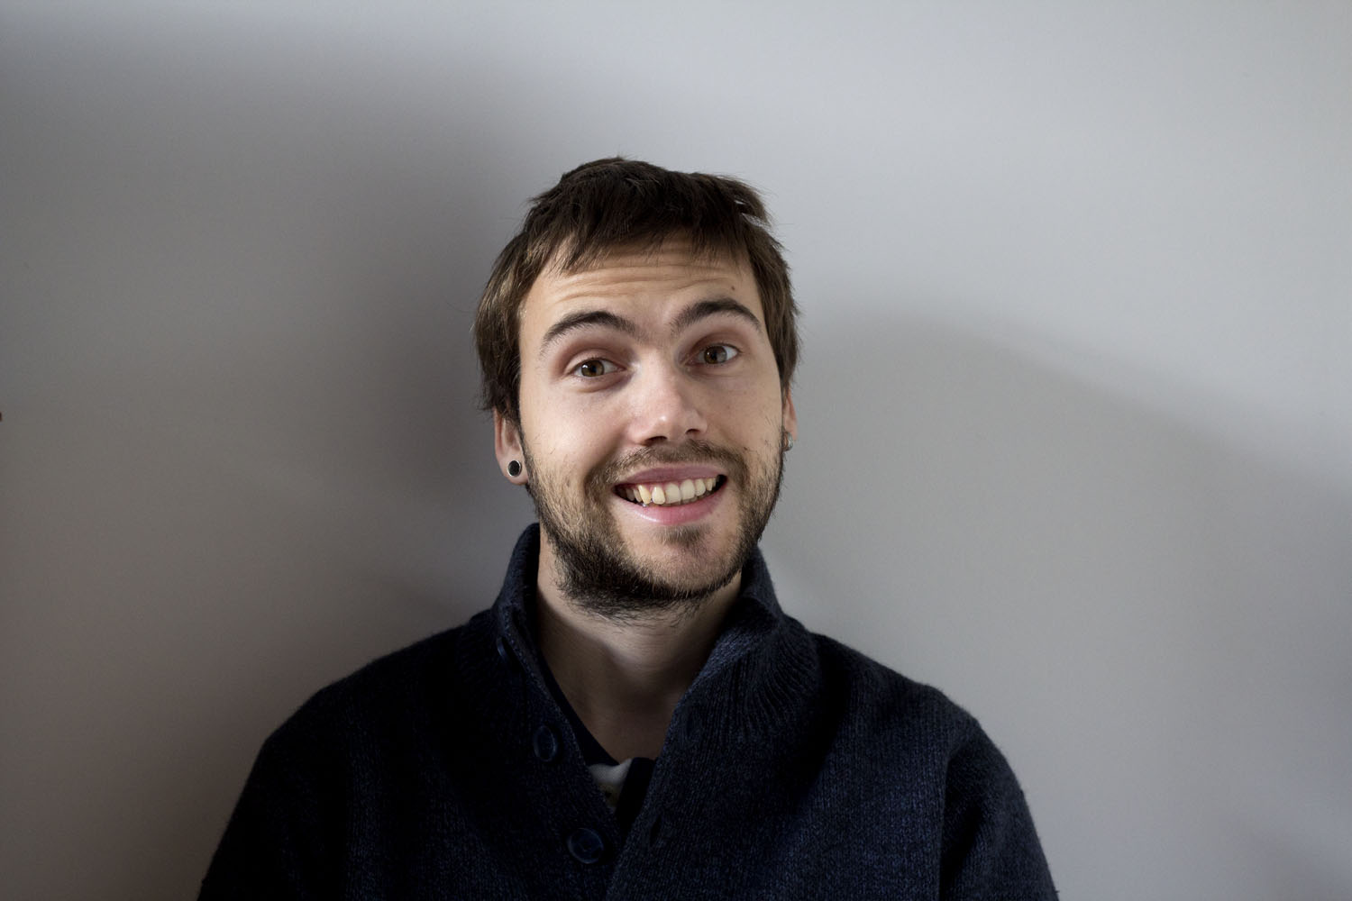

Slide 21
You have 10 seconds to write.

Slide 22
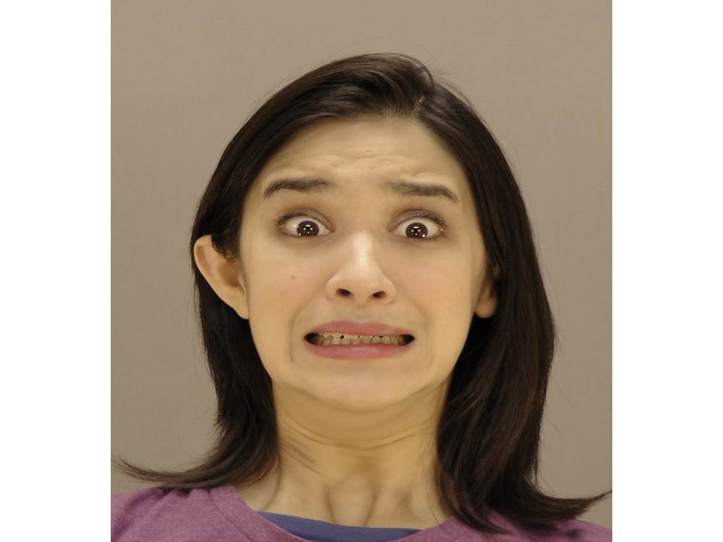

Slide 23
You have 10 seconds to write.

Slide 24
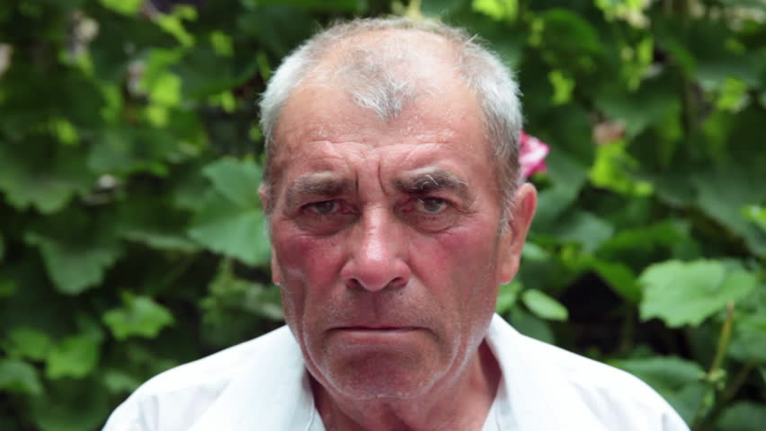

Slide 25
You have 10 seconds to write.

Slide 26
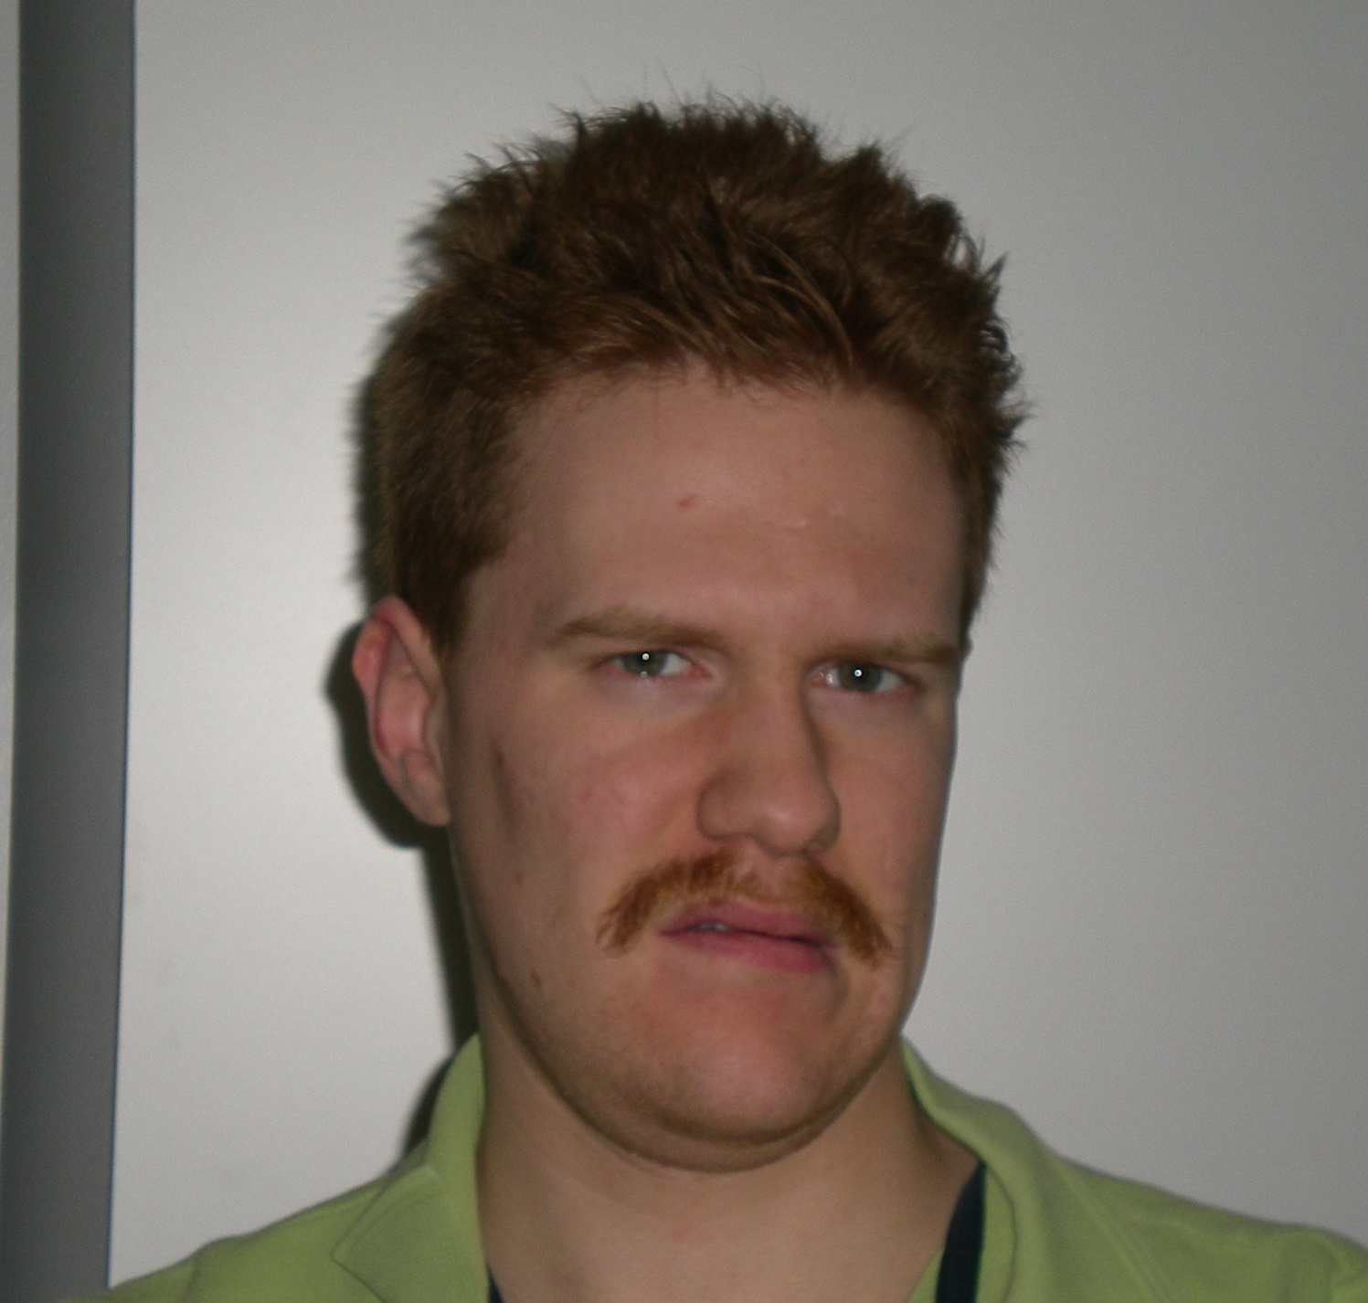

Slide 27
You have 10 seconds to write.

Slide 28
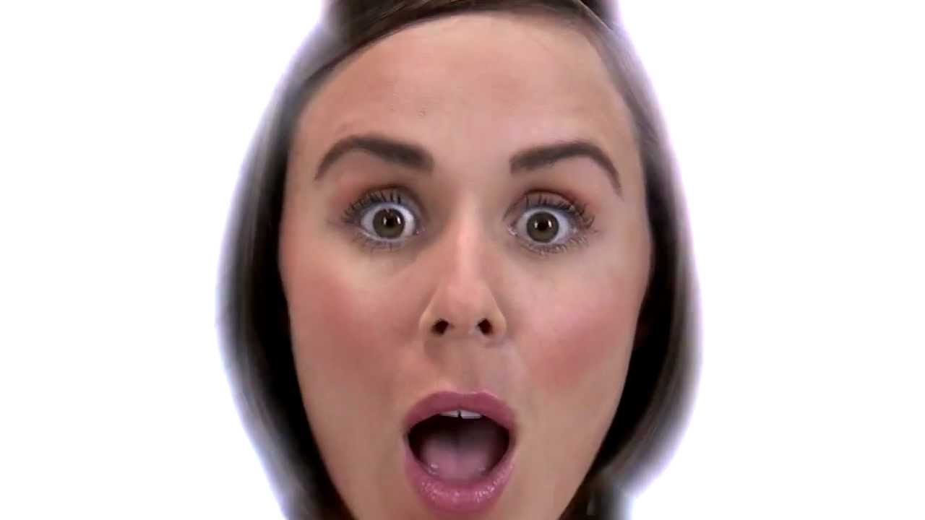

Slide 29
You have 10 seconds to write.

Slide 30
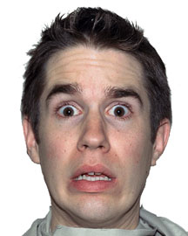

Slide 31
You have 10 seconds to write.

Slide 32
All Done!

